Slide 1

Customer Shopping Behavior Analysis
Uncovering insights from 3,900 purchases to guide strategic business decisions

Slide 2

DATASET OVERVIEW
The Foundation
3.9K
18
$59.76
3.75
Total Purchases
Data Points
Avg Purchase
Avg Rating
Transactions analyzed across all categories
Comprehensive customer and purchase features
Mean transaction value across all customers
Customer satisfaction score

Slide 3

PYTHON ANALYSIS
Data Preparation Journey
01
02
03
Data Loading & Exploration
Missing Data Handling
Feature Engineering
Imported dataset, checked structure and summary statistics
Imputed 37 missing review ratings using category medians
Created age groups and purchase frequency metrics
04
05
Data Consistency
Database Integration
Standardized columns, removed redundant promo code field
Connected to PostgreSQL for advanced SQL analysis

Slide 4
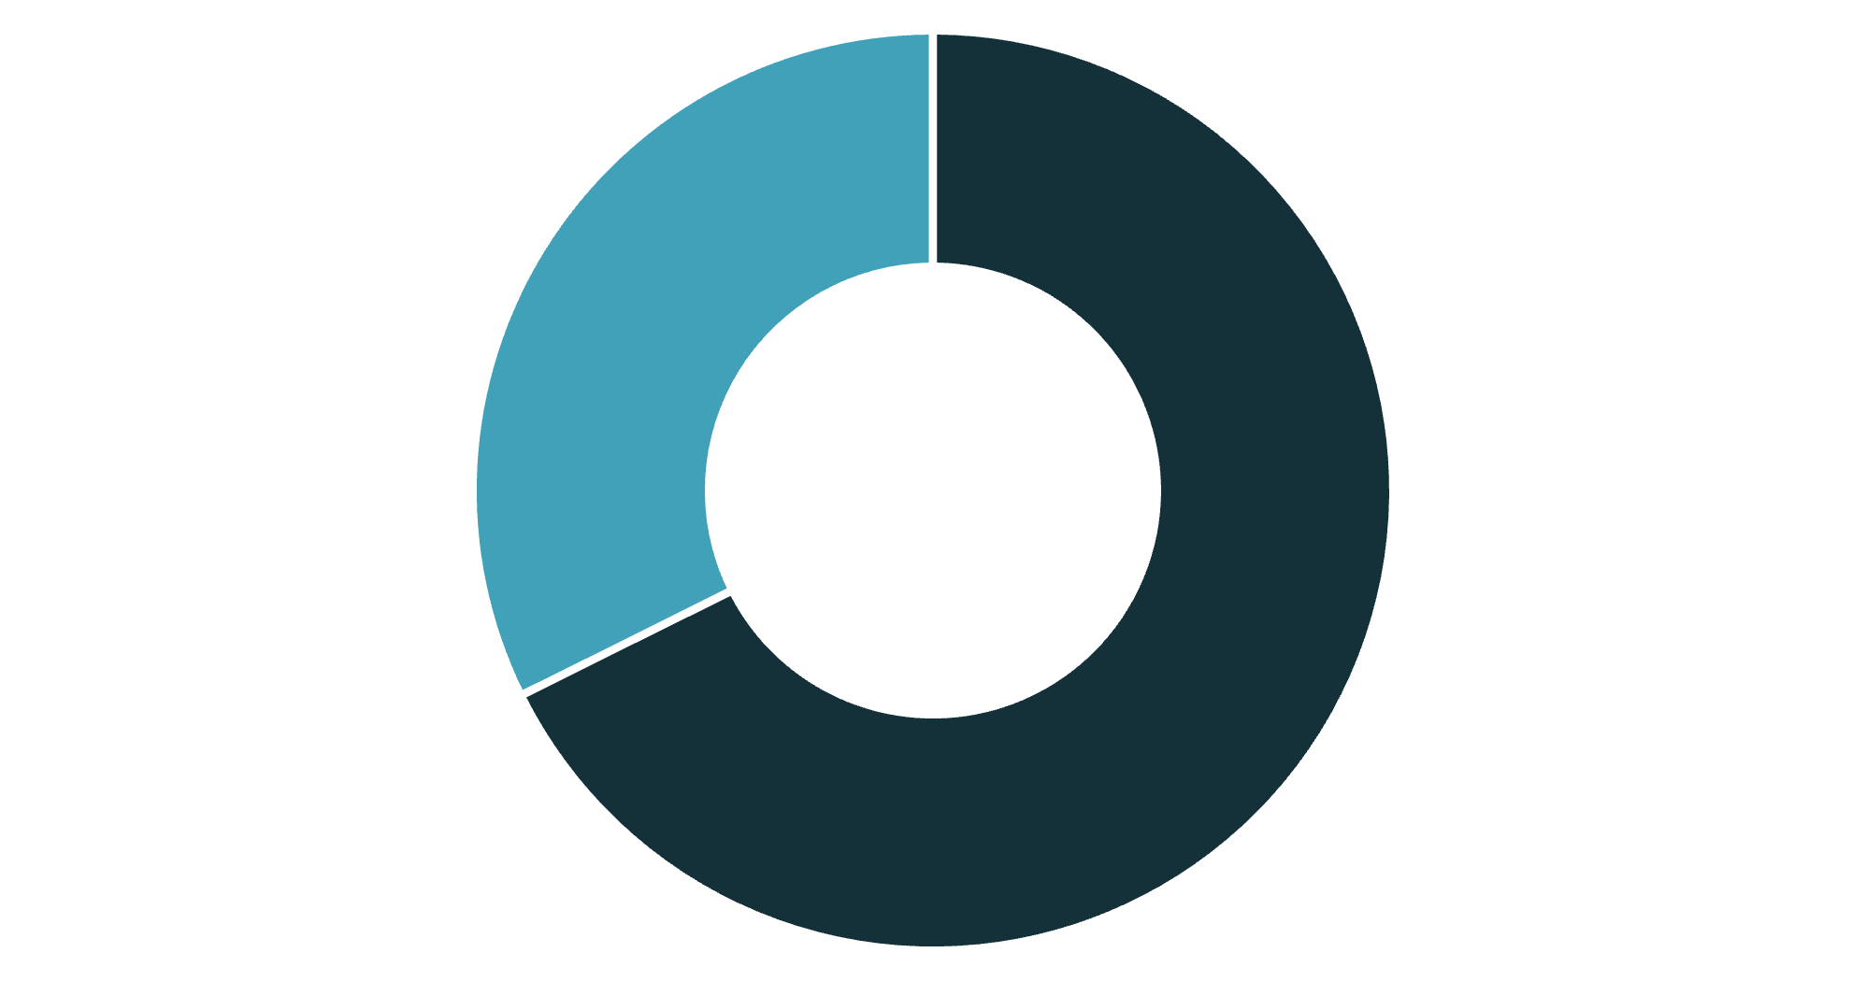
SQL INSIGHTS
Revenue by Gender
Male customers drive revenue
Male shoppers generate 68% of total revenue, significantly outpacing female customers.
This insight suggests targeted marketing opportunities for both segments.
Male
Female

Slide 5

Top-Rated Products
1
2
3
Gloves
Sandals
Boots
Rating: 3.86
Rating: 3.84
Rating: 3.82
4
5
Hat
Skirt
Rating: 3.80
Rating: 3.78
These products consistently deliver customer satisfaction and should be featured prominently in marketing campaigns.

Slide 6



CUSTOMER SEGMENTS
Understanding Our Customer Base
Returning
701 customers
Engaged shoppers with growth potential
Loyal
3,116 customers
Repeat purchasers driving consistent revenue
New
83 customers
Fresh opportunities for conversion

Slide 7
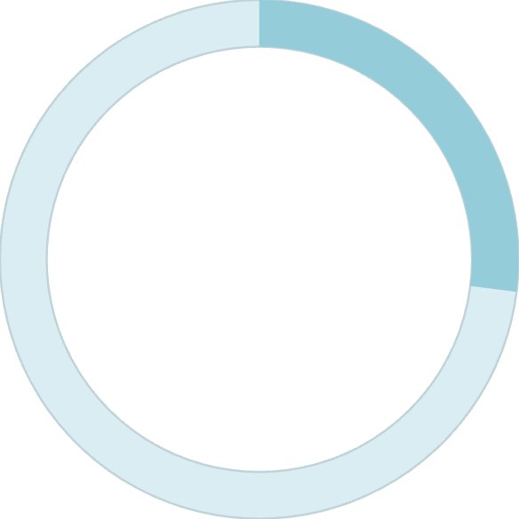
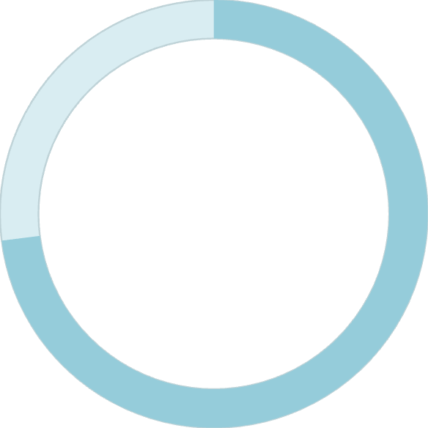
Subscription Status Analysis
Subscription Opportunity
Despite similar average spend ($59.49 vs $59.87), massive untapped potential exists in converting non-subscribers.
27%
958 repeat buyers with 5+ purchases haven't subscribed yet.
Subscribers
1,053 customers enrolled
73%
Non-Subscribers
2,847 customers

Slide 8
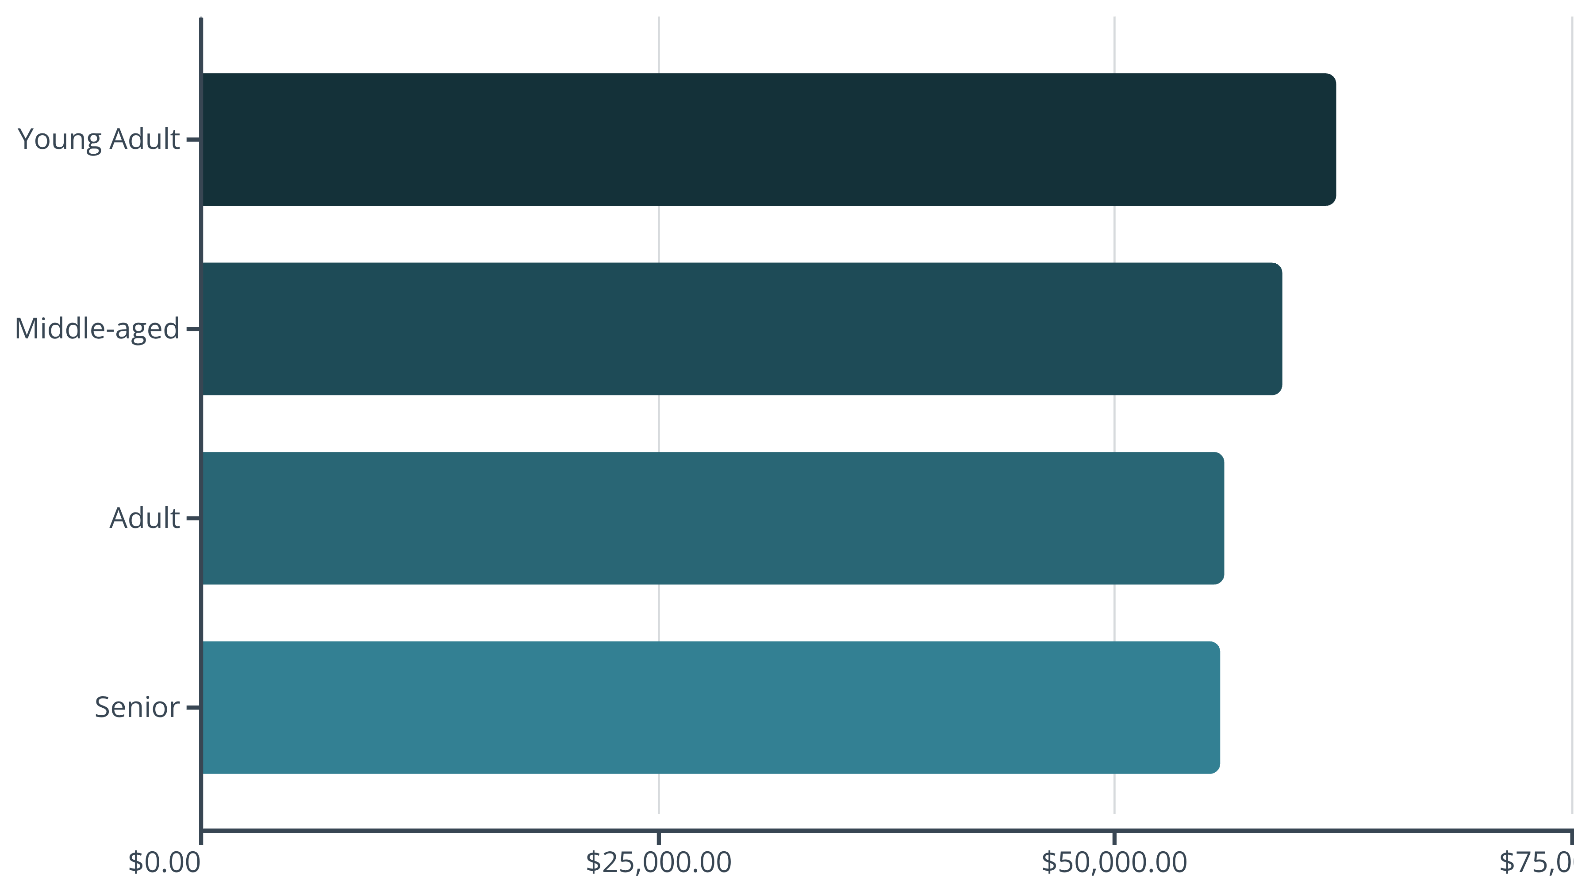
REVENUE INSIGHTS
Revenue by Age Group
Young adults lead revenue generation, but all age groups contribute relatively evenly—indicating broad market appeal.

Slide 9
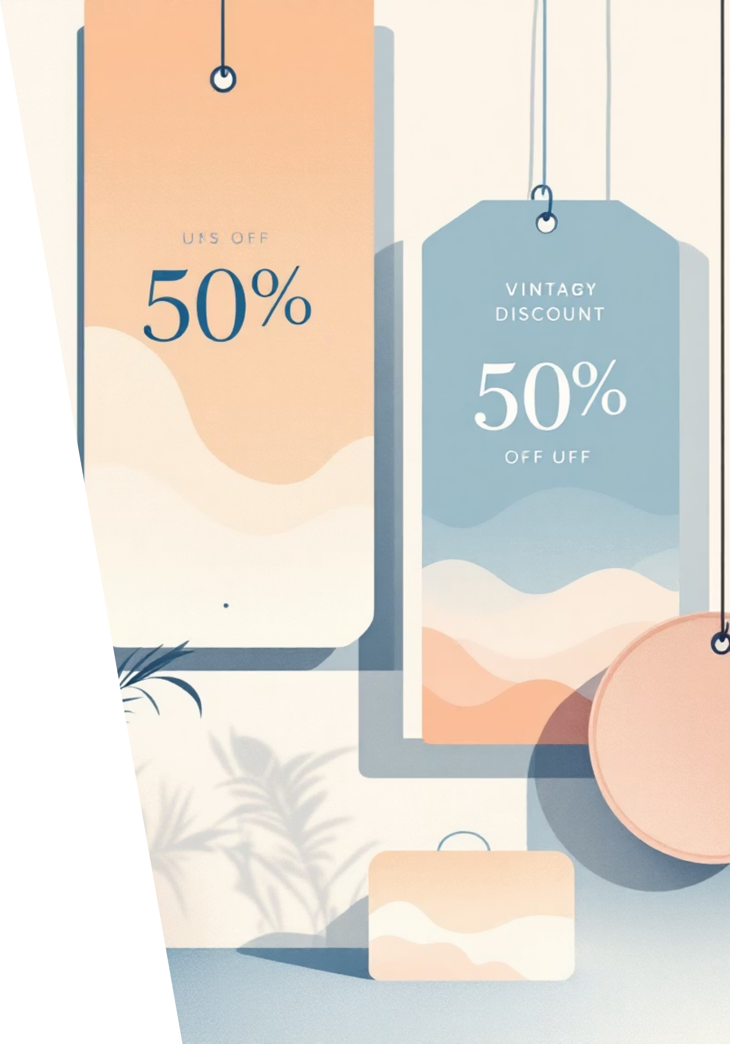
Discount Strategy Insights
High-Value Discount Users
Discount-Dependent Products
839 customers used discounts but spent above average ($60+)
Hat (50%), Sneakers (49.66%), Coat (49.07%) rely heavily on promotions
Shipping Impact
Express shipping customers spend $2 more on average than standard

Slide 10

ACTION PLAN
Strategic Recommendations
Boost Subscriptions
Promote exclusive benefits to convert 2,847 non-subscribers
Loyalty Programs
Reward 958 repeat buyers to strengthen retention
Review Discount Policy
Balance sales boosts with margin control on high-discount products
Targeted Marketing
Focus on young adults, express shipping users, and top-rated products

